Slide 1
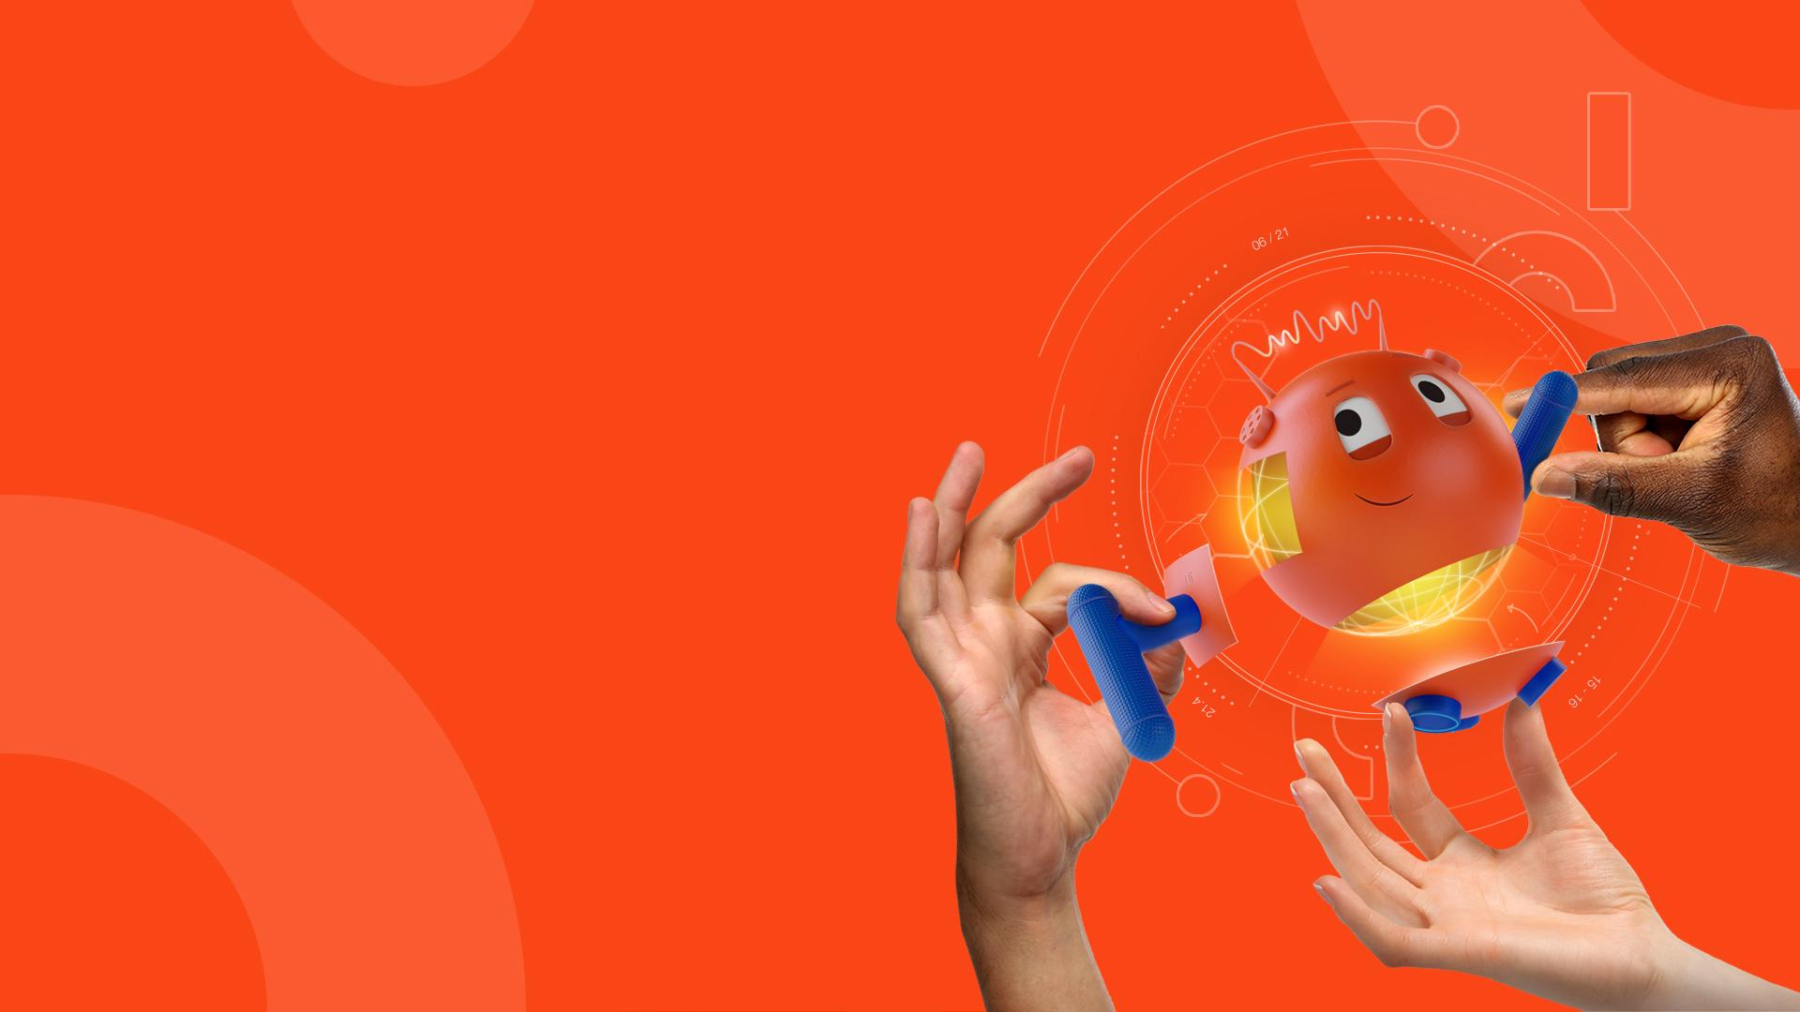
Home Remedy App
Team Name: ROCKERS

Slide 2
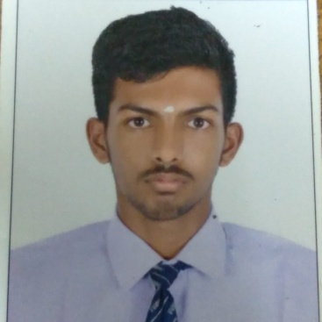
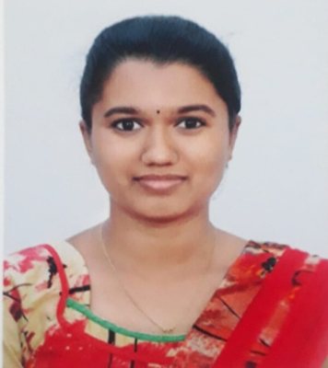
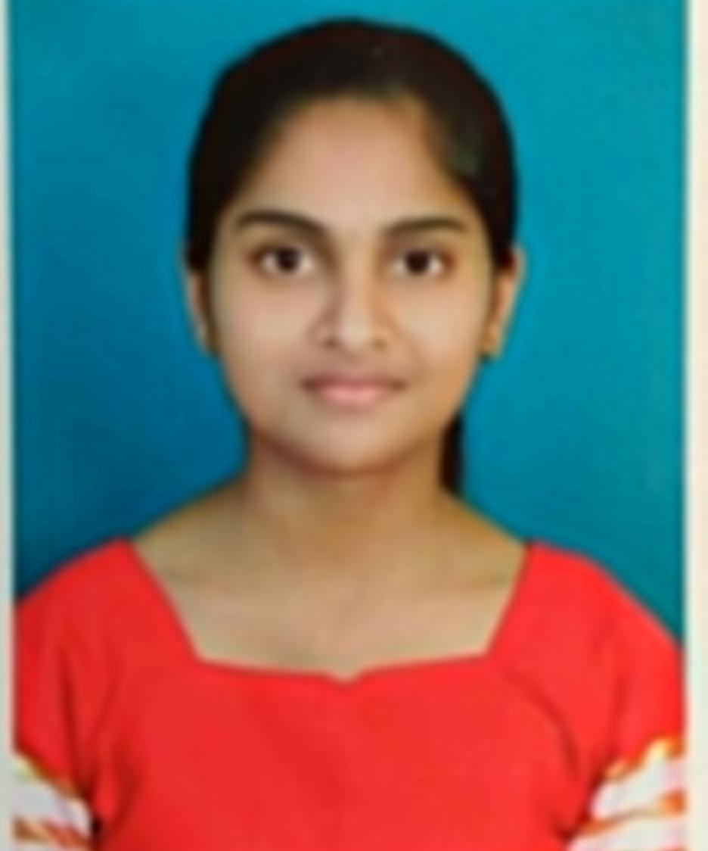
Team Slide
Sai Esvar P.
Swathi S.
Ghetanjali M.
KGCAS
saiesvar42206@gmail.com
KGCAS
srisakthicbe2211@gmail.com
KGCAS
ghetanjali25@gmail.com
Notes:
Please replace photograph with your team member by right click on image > change picture
Please add role and company name and add your email ID.
Feel free to remove extra picture and details if team size is smaller

Slide 3
Problem Statement & Proposed Solution
Problem
Solution
Developed an app in UiPath to help the people with home remedies.
App that contains home remedies which help the individual to cure health issues with the help of UiPath bot.
Notes:
Problem: Please briefly mention what is the problem you are trying to solve / what is problem statement Solution: What approach you took to solve the problem/ what is the solution / your solution to the problem

Slide 4
Benefits & Technologies Used
Details
Benefits
End-User | People in need of first-aid
User Department | Health Care
Industries | Medical
UiPath Products Used | UiPath Studio, UiPath Assistant and Orchestrator
Other – Integrations / APIs / Technologies Used
User could get the first aid tips which is relevant to their medical emergencies.
App provide home remedies helps a person to prevent and reduce the sudden illnesses and medical conditions.
Notes:
Details: Its always good to share details like who is the end-user of your solution, which department/industry will benefit and what technologies have been used.
Benefits: Please include key features / value proposition of your solution

Slide 5
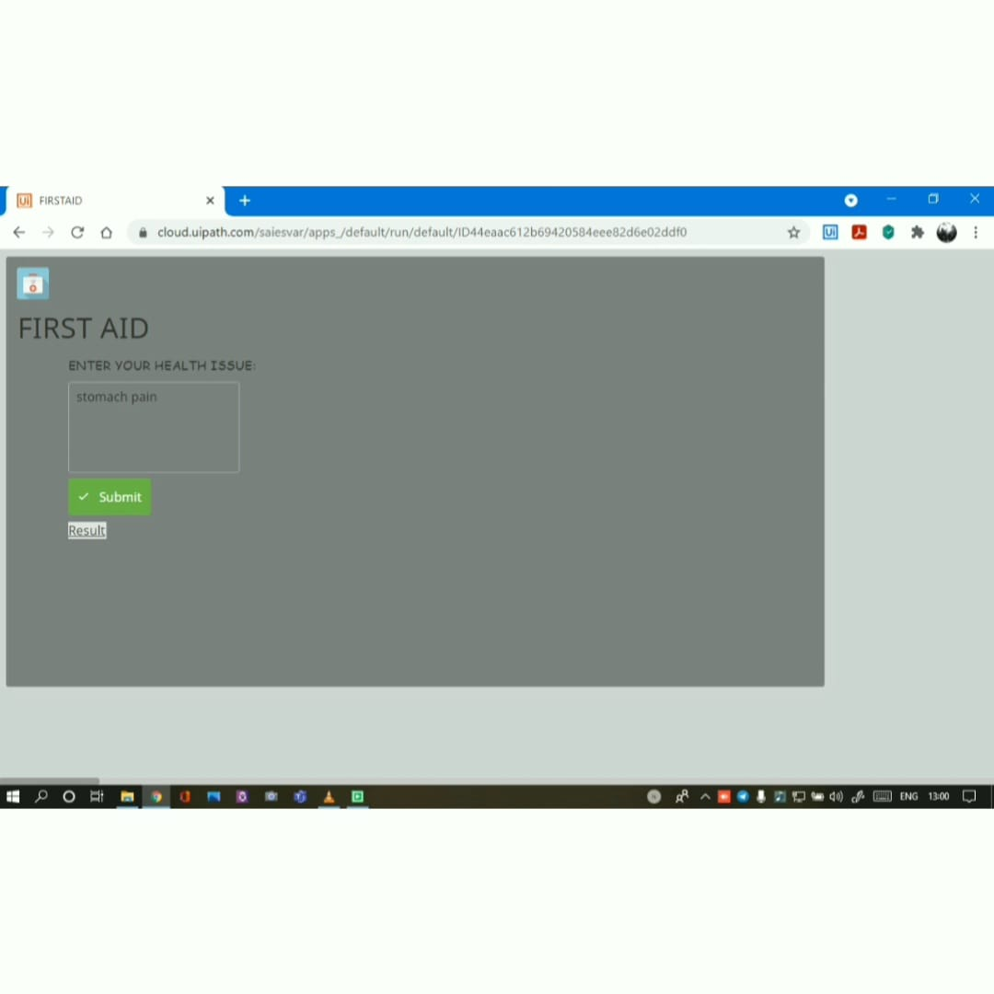
Solution Architecture
Get the input from the user for their health issues.

Slide 6
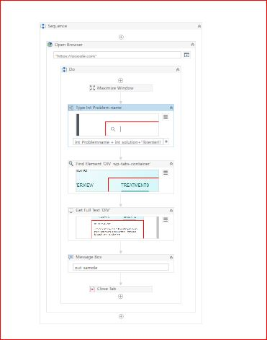
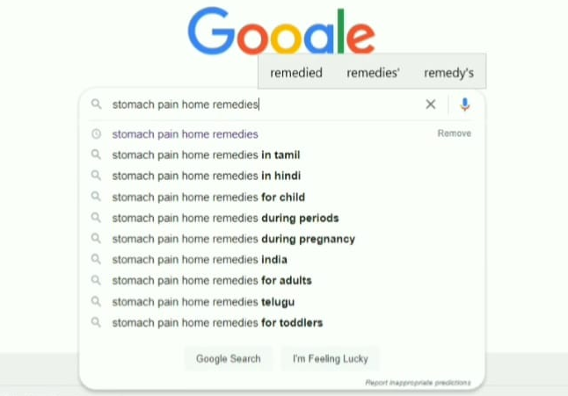
search the relevant home remedies or first aid for their medical condition.
This process is done with the help of UiPath Studio.

Slide 7
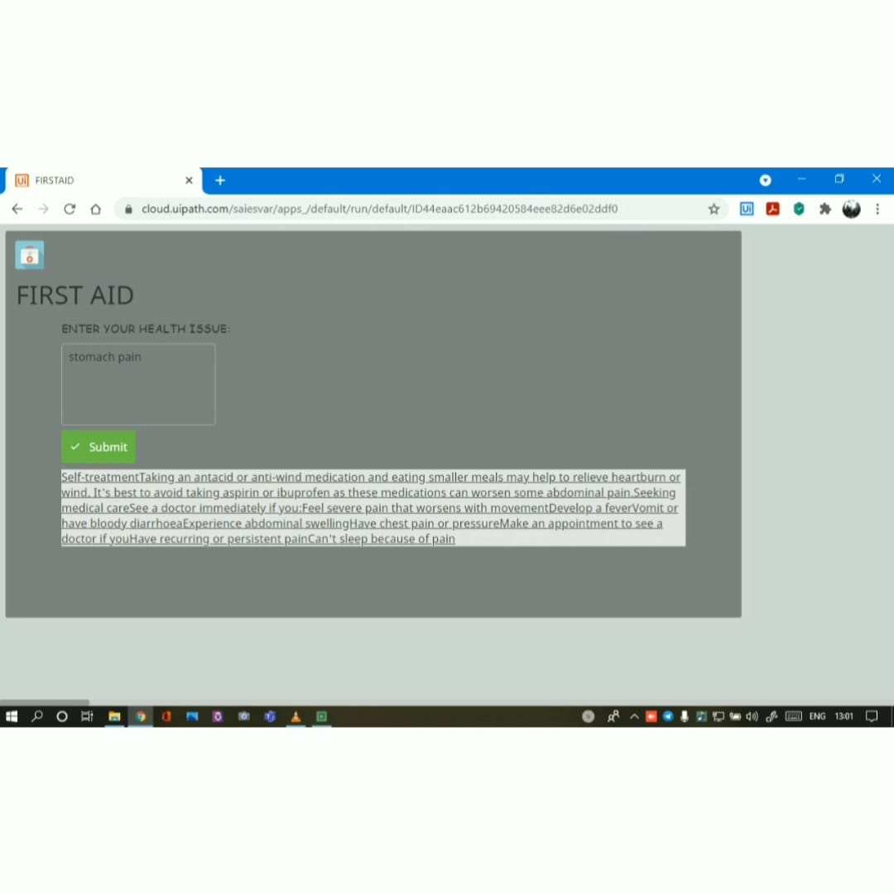
Display the result as the home remedies for the give health issues by extracting data from the Google.

Slide 8


